Slide 1
Predicting Prevalence of Influenza-Like Illness From Geo-Tagged Tweets
AdViser: Jia-Ling,Koh
Source: WWW’17
Speaker: Ming-Chieh,Chiang
Date: 2018/02/27

Slide 2
OutLine
Introduction
Method
Experiment
Conclusion

Slide 3
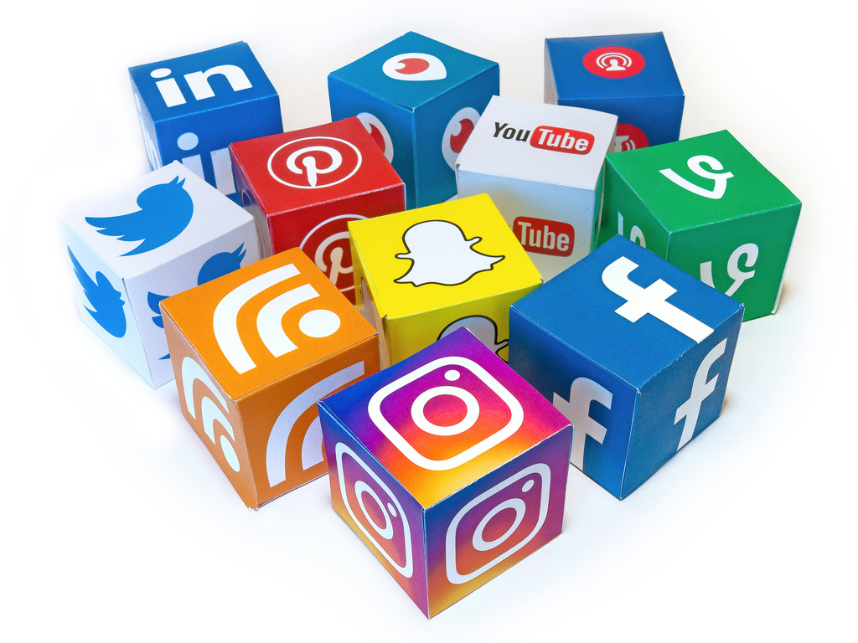
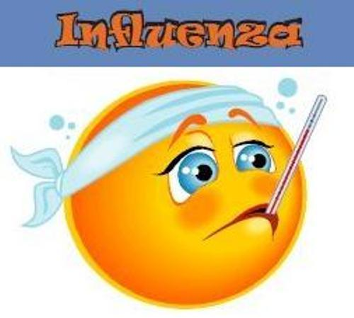
Motivation

Slide 4
Motivation
Modeling disease spread with Twitter data involves several challenges
Only relying on text classification can include large errors

Slide 5
GOAL
A strong positive linear correlation exists between the number of ILI-related tweets and the number of recorded influenza notifications at state scale

Slide 6
OutLine
Introduction
Method
Experiment
Conclusion

Slide 7
Method
Obtain a set of labeled training data
Apply a semi-supervised cascade learning approach to learning SVM classifiers
Distinguish “sick” tweets and “other” tweets

Slide 8
Training SVM classifiers

Slide 9
Training SVM classifiers
Two parameters: class weight and C parameter
Fix one parameter and vary the other within a wide range of values

Slide 10
Classification Stage

Slide 11
Classification Stage
Features: unigram, bigram, trigram
Example:
“ I got the flu” -> (i, get, flu, i get, get flu, i get flu)
Use TF-IDF features to represent tweet data

Slide 12
Modeling Illness Prevalence
Fit a linear regression model
The number of influenza notifications in each state:
Internet access * Twitter penetration rate

Slide 13
OutLine
Introduction
Method
Experiment
Conclusion

Slide 14
Experiment
CSIRO
Geo-tagged tweets within Australia for the entire year of 2015
8,961,932 tweets
225,641unique users

Slide 15
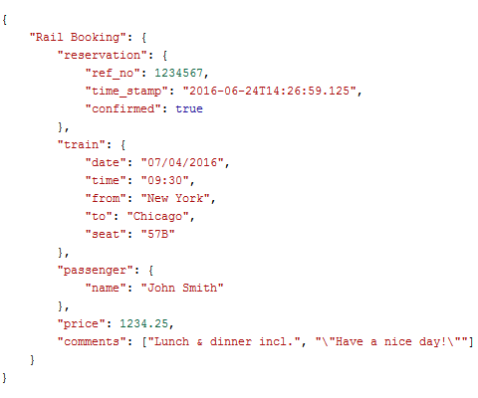
Experiment
JSON format
Data cleaning and tokenization

Slide 16
Experiment
Classifier performance
1027 tweets are found to be ILI-related

Slide 17
Experiment
Temporal Analysis

Slide 18
Experiment
Spatial Analysis

Slide 19
Experiment
Regional Spatial Analysis

Slide 20
Experiment

Slide 21
Experiment

Slide 22
Limitation
The scarcity of the tweets
The laboratory confirmed influenza notifications are incomplete
Twitter is more popular among younger generations
Manual checking

Slide 23
OutLine
Introduction
Method
Experiment
Conclusion

Slide 24
Conclusion
Propose effective modifications to the state-of-art approach in detecting illness-related tweets
Twitter data is a reasonable proxy for detecting disease outbreak and possesses strong linear correlation with real-world influenza notification data

